Slide 1
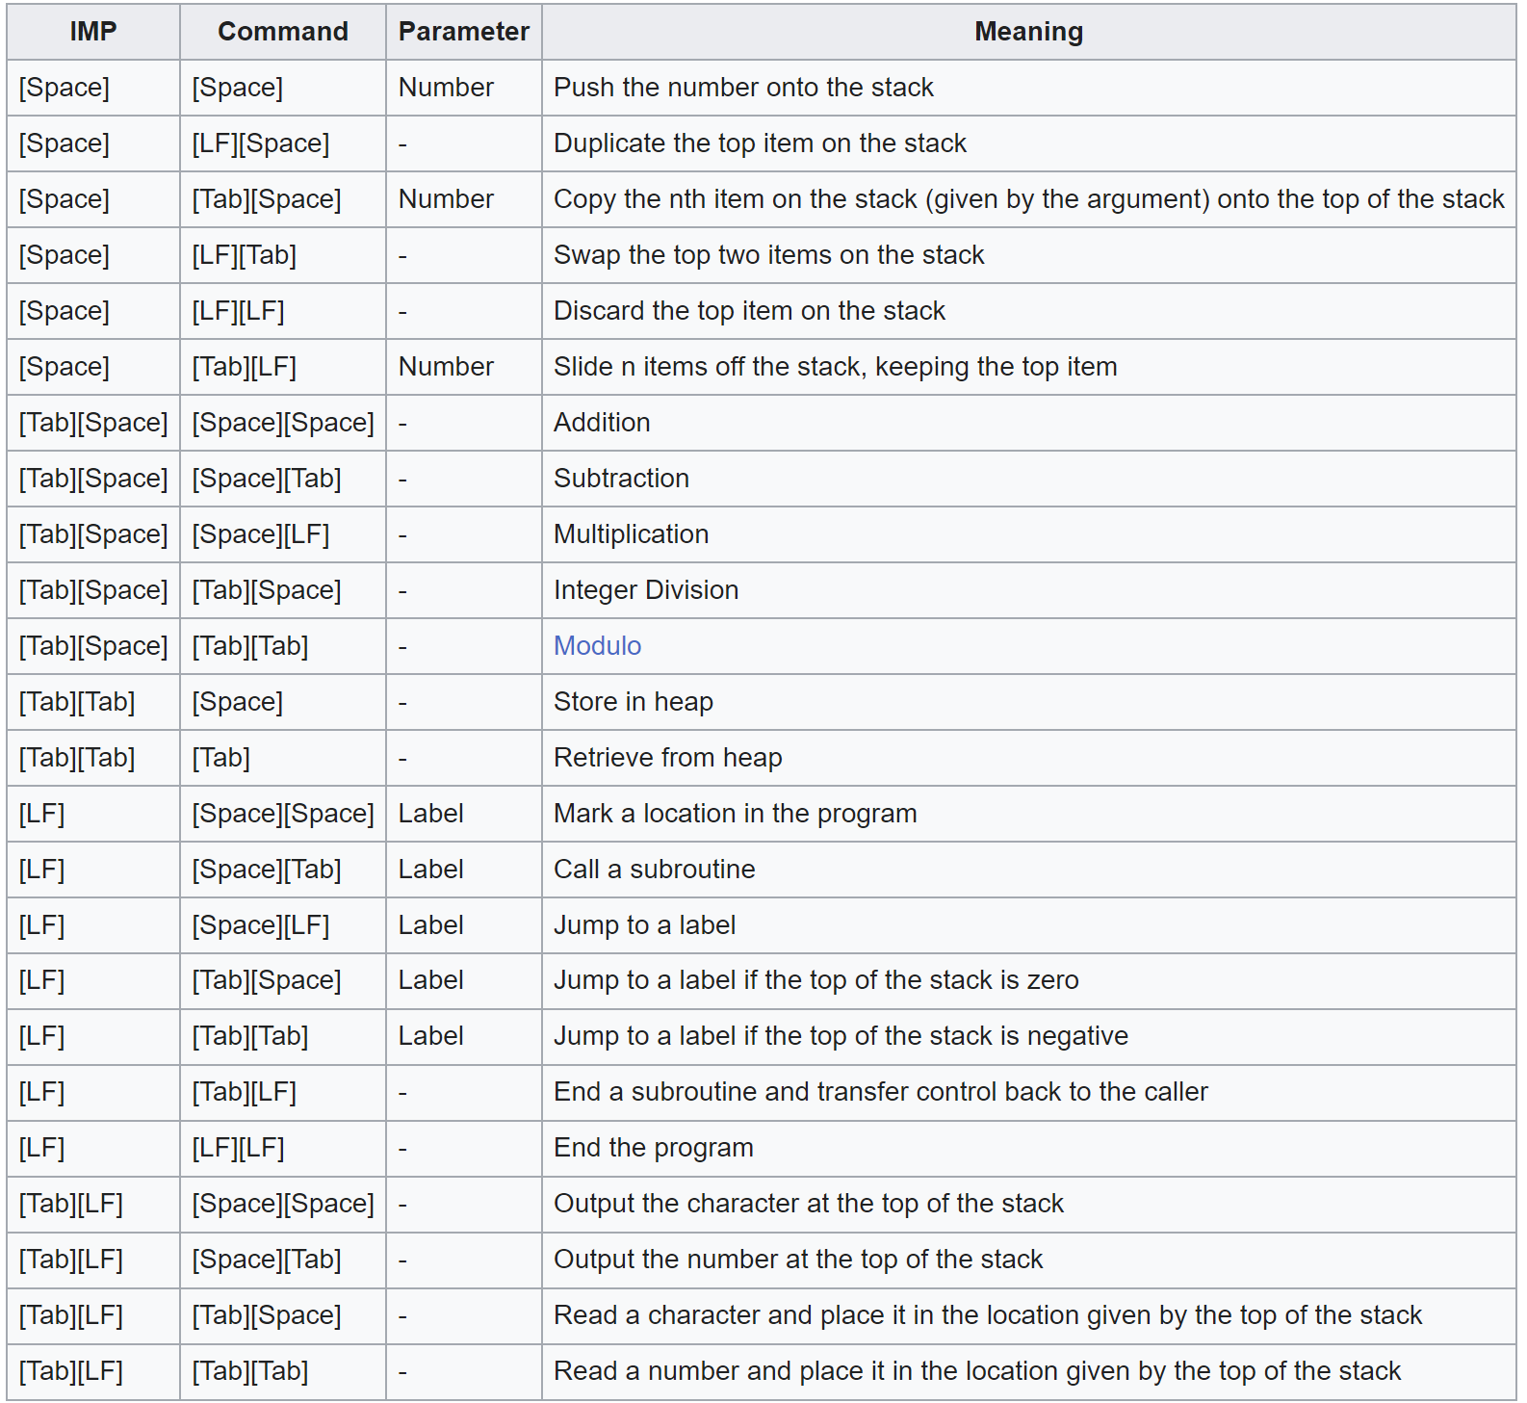
HWOTD: Whitespace
Whitespace is an Esoteric language, AKA a language that is made for fun and usually ridiculous, made on April 1st 2003.
It is an imperative stack-based language
There are only 5 acceptable characters, but with combinations they can do a lot more than you can think

Slide 2
Hello World

Slide 3
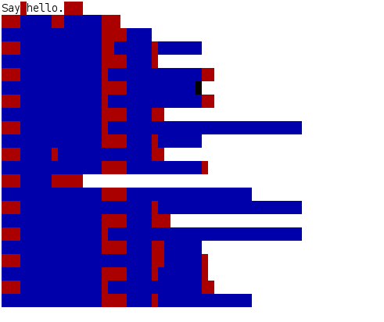
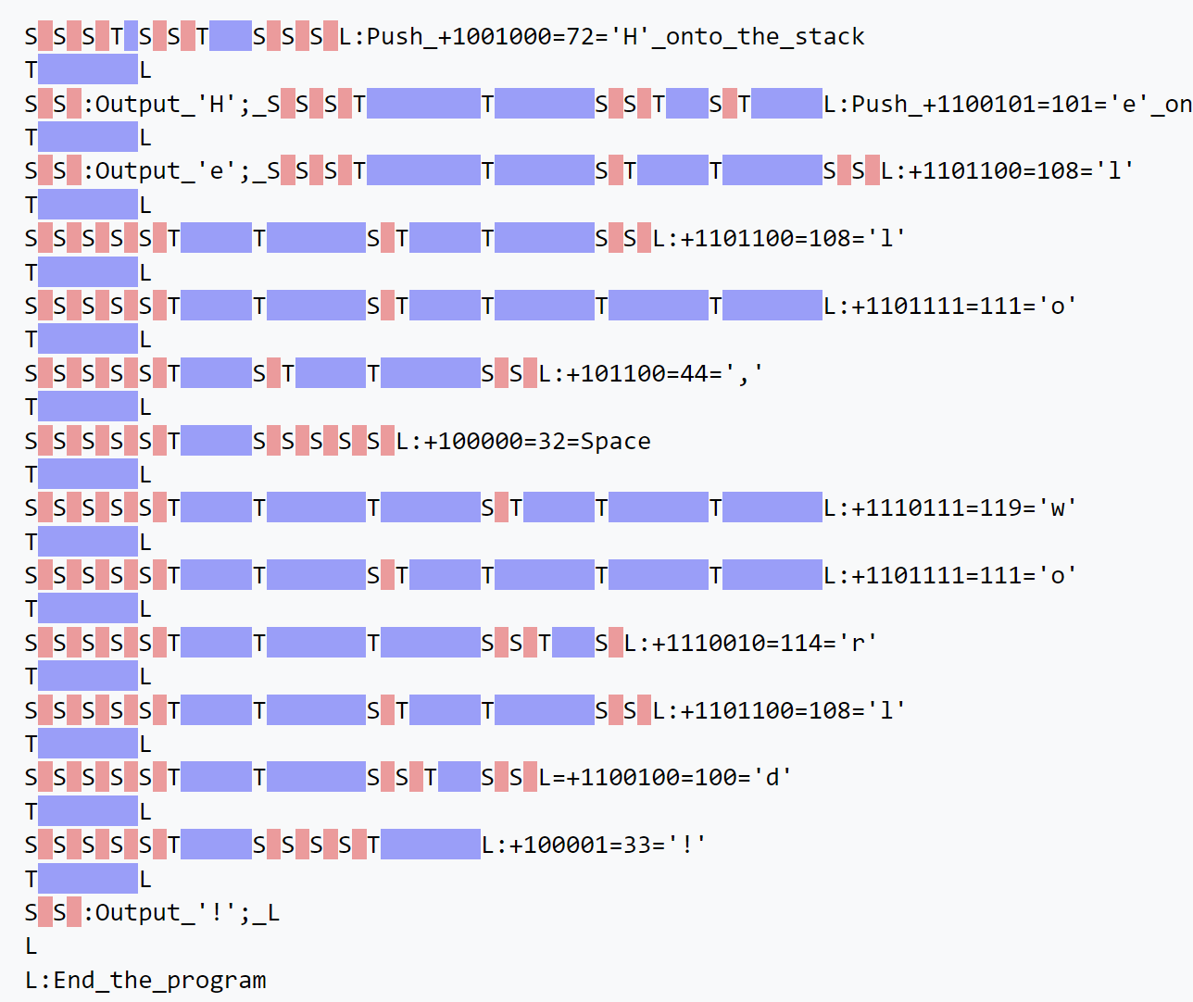
Hello World

